Slide 1



Slide 2


Slide 3


Slide 4


Slide 5
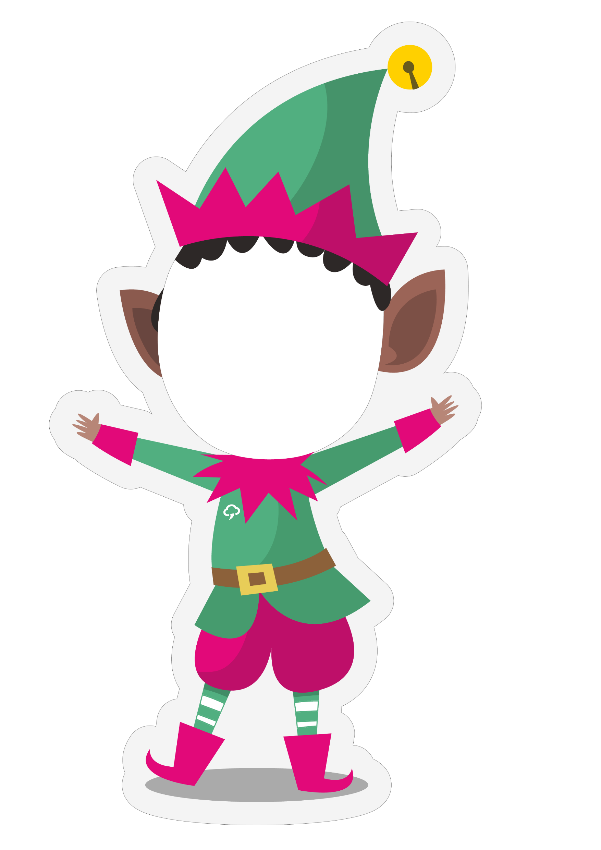

Slide 6

FELEZ
NEVEDED

Slide 7
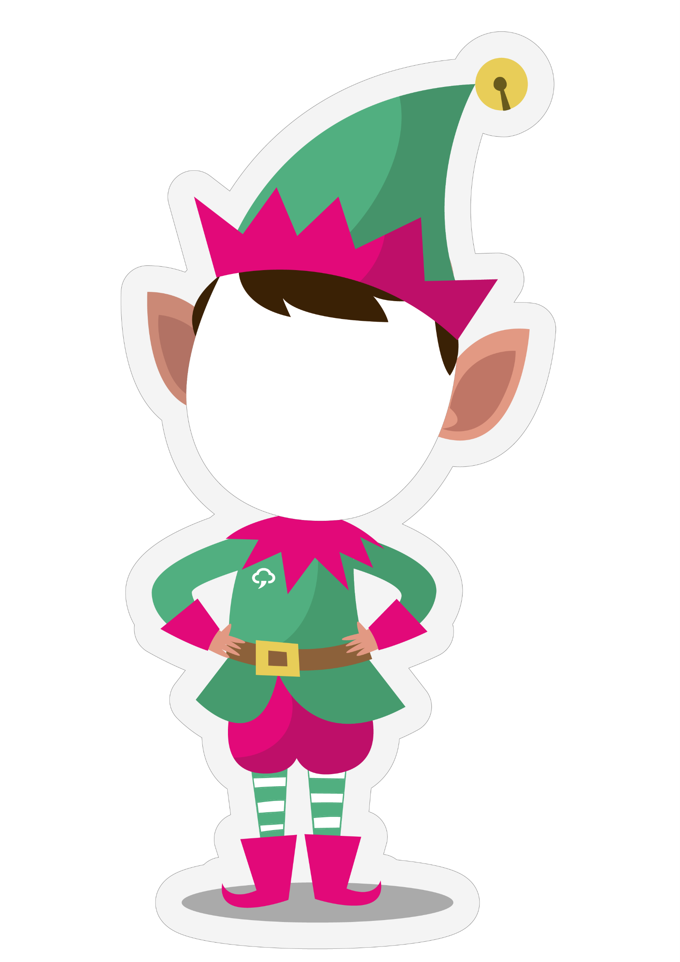

Slide 8


